Slide 1
Lecture 7: Gestalt Principles
DS 4200
Spring 2023
Prof. Ab Mosca (they/them)
Northeastern University
Slides and inspiration from Cody Dunne, Michelle Borkin, Krzysztof Gajos, Hanspeter Pfister,
Miriah Meyer, Jonathan Schwabish, and David Sprague

Slide 2
Last Class
We:
Reviewed color
Practiced JavaScript (ic-05)
Any Questions?

Slide 3
Reminder
Make sure you have a project group!

Slide 4
Today
Review Gestalt Principles
More JavaScript (ic-06)

Slide 5
Gestalt Principles

Slide 6
Gestalt Principles
German “Gestalt” = form
Patterns transcend the visual stimuli that produced them
Ware, VTFD
Notes:
Let’s start by defining Gestalt principles.
The word Gestalt is German, and it means form
What Gestalt Principles refer to are patterns that transcend the visual stimuli that produce them. In other words, the global effects of things like grouping, alignment, and connection in visual stimuli.

Slide 7
Gestalt Principles
Figure-ground
Similarity
Proximity
Common region
Continuity
Closure
Focal point
Based on Slide by M. Meyer
Notes:
There are seven specific principles that fall under the category of Gestalt Principles that we’ll look at today.
Those are: <read>
Let’s define each of these and look at some real world examples.

Slide 8
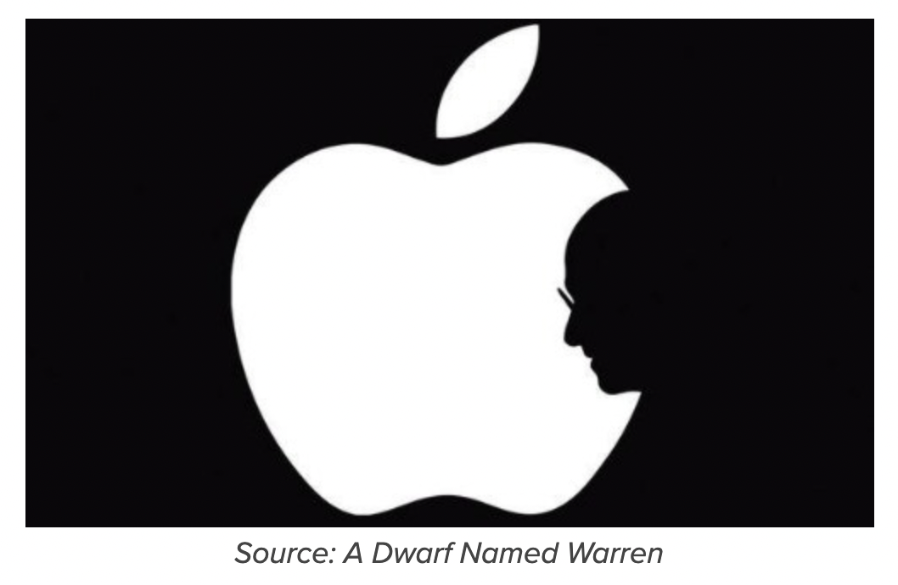
Gestalt Principles
Figure-ground → elements are perceived as either figures or background
https://www.usertesting.com/blog/gestalt-principles
Based on Slide by M. Meyer
Notes:
First we have figure-ground, which refers to the concept that people tend to perceive elements of a visual stimuli as either figures or background.
For example here, you can view the white part of this image as a figure (an apple with a bit missing), or as the background to the silhouette of a face. <next>

Slide 9
Gestalt Principles
Figure-ground → elements are perceived as either figures or background
https://en.wikipedia.org/wiki/Gestalt_psychology
Based on Slide by M. Meyer
Notes:
Another example is this image, where you can view the black a a figure and see a chalice, or as background to the silhouettes of two faces.

Slide 10
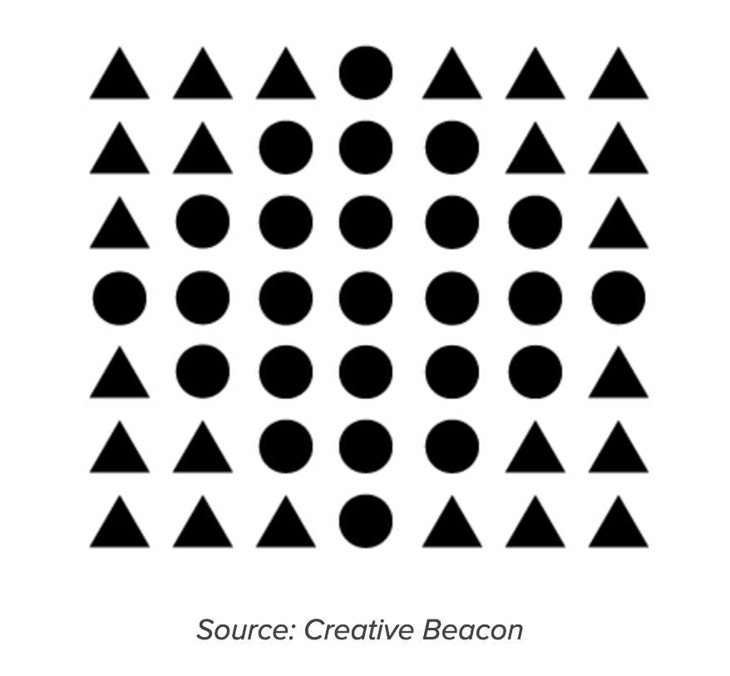
Gestalt Principles
Similarity → we perceive things that look like each other (size, color, shape) as related
https://www.usertesting.com/blog/gestalt-principles
Based on Slide by M. Meyer
Notes:
The next principle is similarity, which refers to the concept that people perceive things that look alike as related.
For example in this image, most people would perceive each item represented by a circle as belonging to one group, and teach item represented by a triangle as relating to another group.

Slide 11
Gestalt Principles
Similarity → we perceive things that look like each other (size, color, shape) as related
https://www.usertesting.com/blog/gestalt-principles
Based on Slide by M. Meyer
Ware, VTFD
Notes:
We heavily leverage this principle when we’re encoding categorical data; to distinguish between groups of items we’ll use different colors and / or shapes. It’s because of gestalt principles that this encoding works so effectively without any explanation.

Slide 12
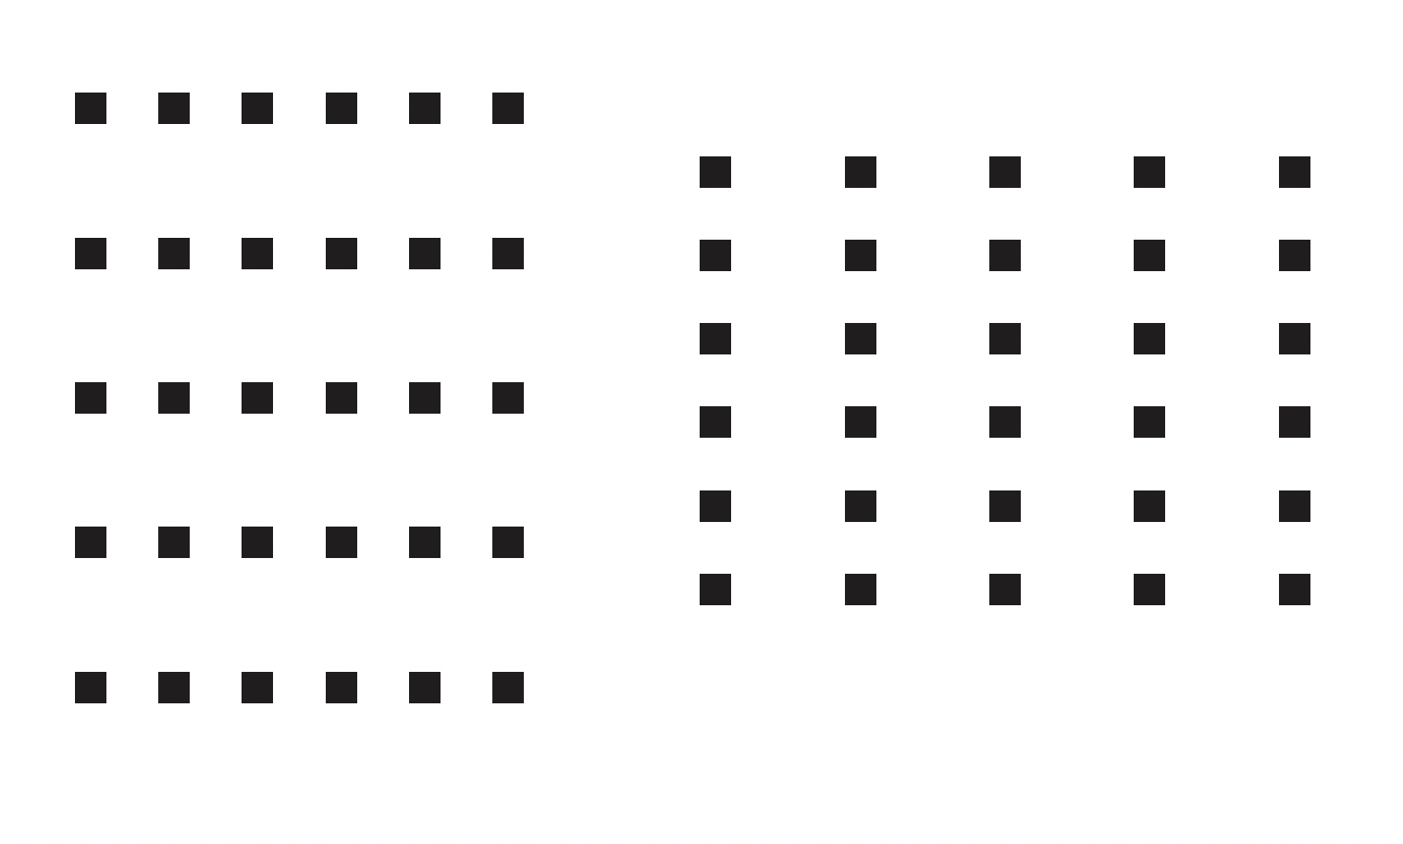
Gestalt Principles
Proximity → we perceive things that are visually close to each other as related
Bang Wong, “Gestalt principles (Part 1)” (Nature Methods)
Based on Slide by M. Meyer
Notes:
The third principle is proximity, which refers to the concept that people tend to perceive things that are visually close to each other as related.
For example, the images on the left and right of this slide both show 5 X 5 grids of points.
On the left, they are arranged with more space between rows than columns, resulting in most people seeing them as being arranged in rows.
On the right, they are arranged with more space between columns than rows, resulting in most people seeing them as being arranged in columns.

Slide 13

Gestalt Principles
Proximity → we perceive things that are visually close to each other as related
Bang Wong, “Gestalt principles (Part 1)” (Nature Methods)
Based on Slide by M. Meyer
Notes:
This principle is leveraged a lot in logo design. For example, the fact that IBM arranges horizontal lines in particular proximities results in us seeing those lines as forming the letters IBM.

Slide 14
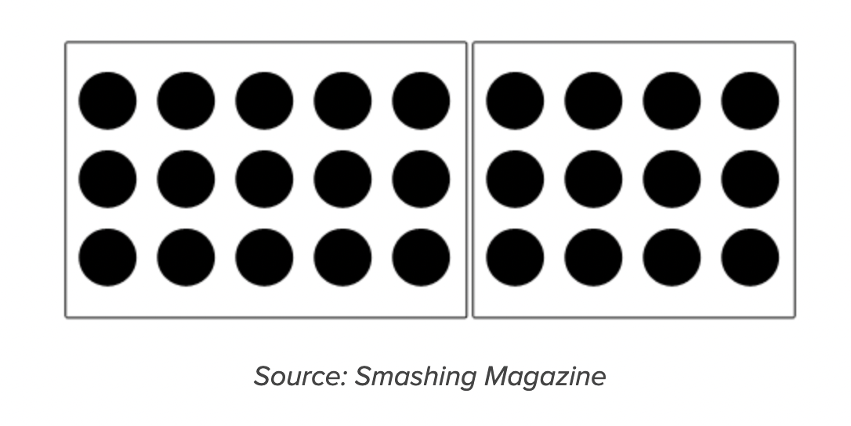
Gestalt Principles
Common region → we perceive items within the same closed region as being grouped
https://www.usertesting.com/blog/gestalt-principles
Based on Slide by M. Meyer
Notes:
The fourth principle is common region, which refers to the concept that people tend to perceive items within the same closed region as being grouped.
For example, the dots shown in the grid here are perceived as being in two groups, determined by the boxes drawn around them.

Slide 15
Gestalt Principles
Common region → we perceive items within the same closed region as being grouped
https://ldld.samizdat.cc/2016/tree-maps/
Based on Slide by M. Meyer
Notes:
This is a another principle we leverage a lot in visualization. For example, it’s one of the reasons treemaps are so effective without having to provide a lot of explanation to users.

Slide 16
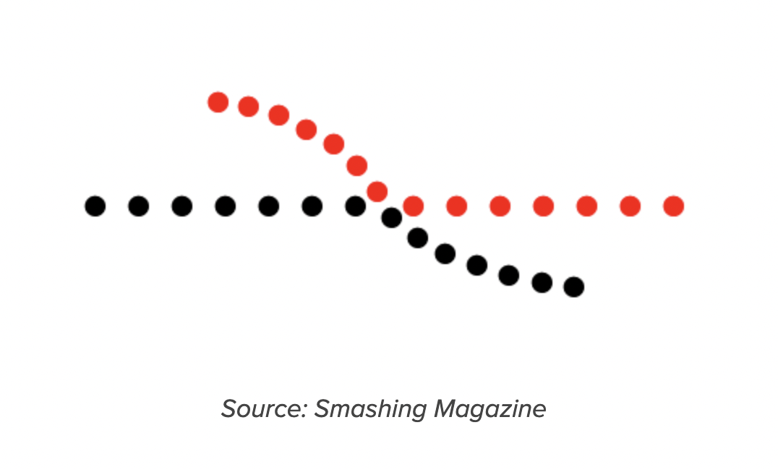
Gestalt Principles
Continuity → items on a line or curve are perceived as more related
https://www.usertesting.com/blog/gestalt-principles
Based on Slide by M. Meyer
Notes:
The fifth principle is continuity, which refers to the concept that items on a line or curve are perceived as more related.
For example, people tend to look at the image shown here and see a curved line and a straight line, which are each half black and half red as opposed to two curved a red and black lines.

Slide 17

Gestalt Principles
Continuity → items on a line or curve are perceived as more related
https://www.usertesting.com/blog/gestalt-principles
Based on Slide by M. Meyer
Notes:
This is another principle that is often used is logos. For example, in the amazon logo the curved arrow implies a relationship between a and z.

Slide 18
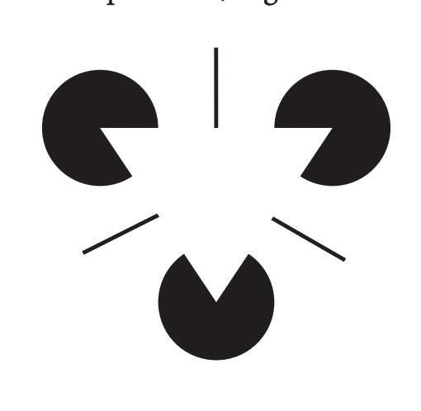
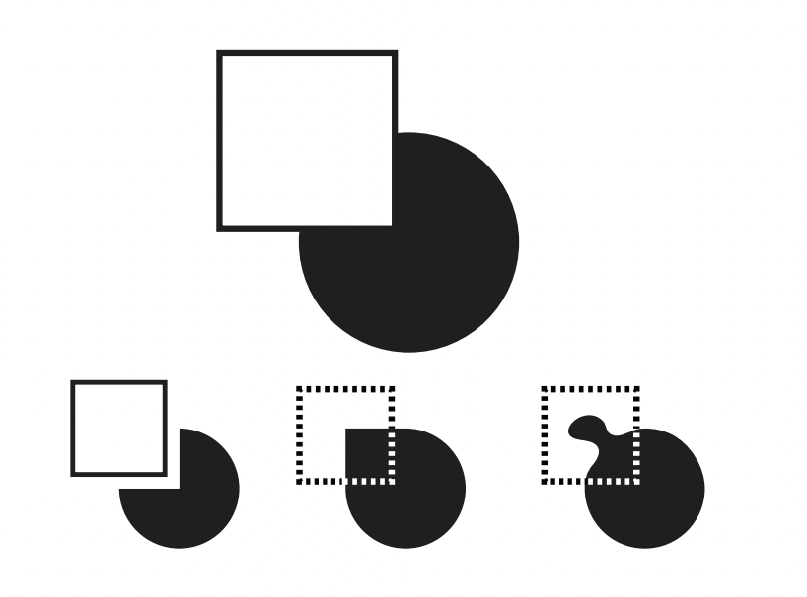
Gestalt Principles
Closure → we see incomplete shapes as complete
Bang Wong, “Gestalt principles (Part 2)” (Nature Methods)
Based on Slide by M. Meyer
Notes:
The sixth principle is closure, which refers to the concept that people tend to see incomplete shapes as complete.
For example, on the left image people tend to infer a white triangle in the center of the image.
In the image on the right, people tend to infer the black object as a circle overlaid by a white square, as opposed to any of the other shapes it could take.

Slide 19

Gestalt Principles
Closure → we see incomplete shapes as complete
Based on Slide by M. Meyer
Notes:
This is another principle that is used a lot in logo creation. For example here the panda bear on the left is inferred, as are the box in the middle and the arrow in fedex.
The fact that you see these shapes even when they are not explicitly draws is explained by the closure principle.

Slide 20
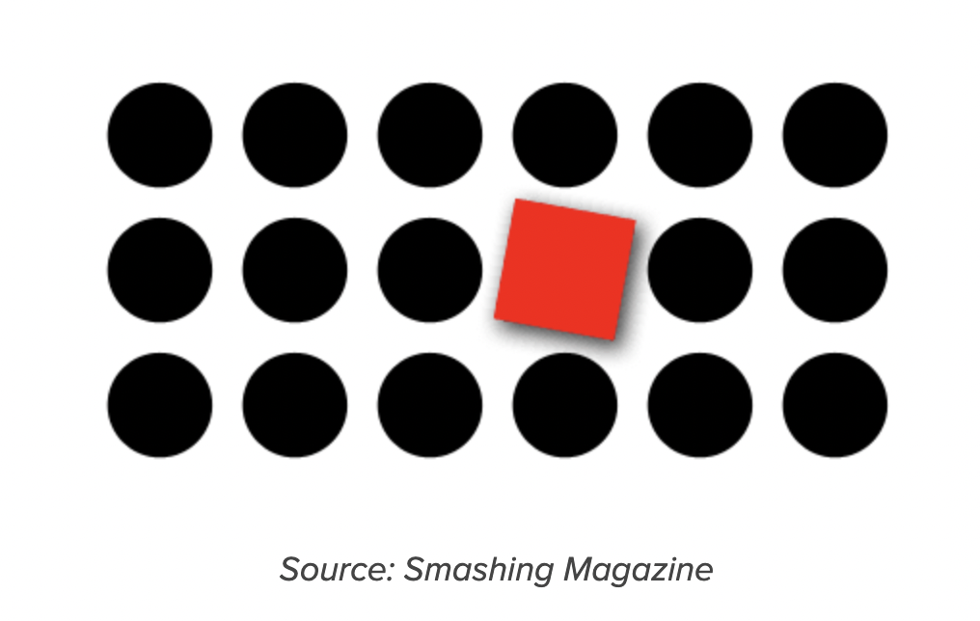
Gestalt Principles
Focal point → whatever stands out will capture the viewers attention first
https://www.usertesting.com/blog/gestalt-principles
Based on Slide by M. Meyer
Notes:
The seventh principle is focal point, which refers to the concept that whatever stands out in an image will capture the viewer’s attention first.
This goes back to the pop-out effect we’ve talked about before. If I color one item red, it will capture the viewers attention first, and will thus stand out from the rest of the image.

Slide 21

Gestalt Principles
Focal point → whatever stands out will capture the viewers attention first
Based on Slide by M. Meyer
Notes:
An example of this principle in action is when you go to your myNortheastern login – red is used to make the go to log in button pop out and catch your attention first.
In comparison, the Request Access button is not immediately visible when you land on this page.

Slide 22
Let’s take a break! Stretch, go for a walk, be social ☺ Be back here in 10 mins.

Slide 23
JavaScript Pt. 2

Slide 24
Summary
Today we:
Reviewed Gestalt Principles
More JavaScript (ic-06)
hw-04 is OUT today.
ic-06 is DUE today.

